Slide 1
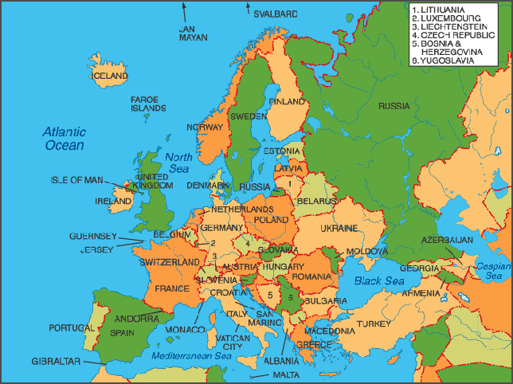
Rhetoric = The Art of Persuasion
The history of rhetoric and the concepts of
ethos, pathos and logos began in Greece.

Slide 2
Aristotle was a famous Greek philosopher. Literally translated from Greek, the word philosopher means one who loves wisdom.
What is a philosopher?
phil
soph
er
philosopher
love
wisdom
one who
philosopher

Slide 3
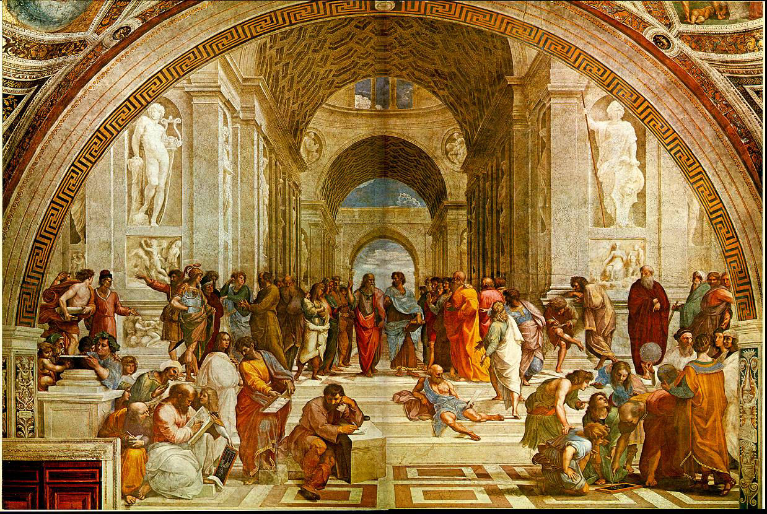
Philosophers Love Learning!
This painting, created by Raphael (1483-1520), is entitled "The School of Athens." This masterpiece depicts an intellectual gathering of the great philosophers of classical times at a school called the Ancient Agora of Athens. The Agora remains standing today in Athens, Greece. The school served as an academic meeting place for the great philosophers of classical times. In particular, this painting portrays Plato, Aristotle and other philosophers engaging in philosophical inquiry. Although this painting depicts Classical antiquity, it was created during the Renaissance.

Slide 4
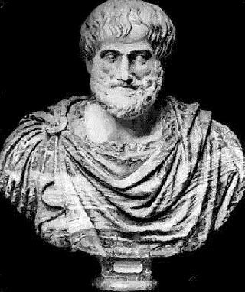

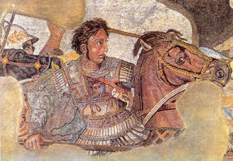
Who was Aristotle?
Aristotle was a famous Greek
philosopher who studied the
art of persuasion.
Plato, another famous Greek philosopher, was his teacher.
Aristotle taught Alexander the Great how to properly argue and perform a public speech.

Slide 5
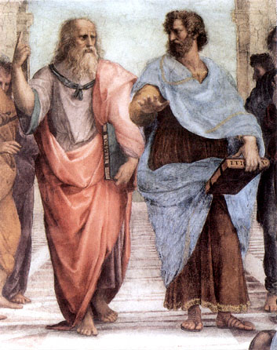

Ethos, Logos and Pathos
In approximately 300 B.C.E. Aristotle, who was a famous Greek philosopher, wrote a book entitled, “The Art of Rhetoric.” In his book, Aristotle identified the three methods of persuasion. He called them ethos, pathos and logos.
Aristotle
Plato
The Man
The Book

Slide 6
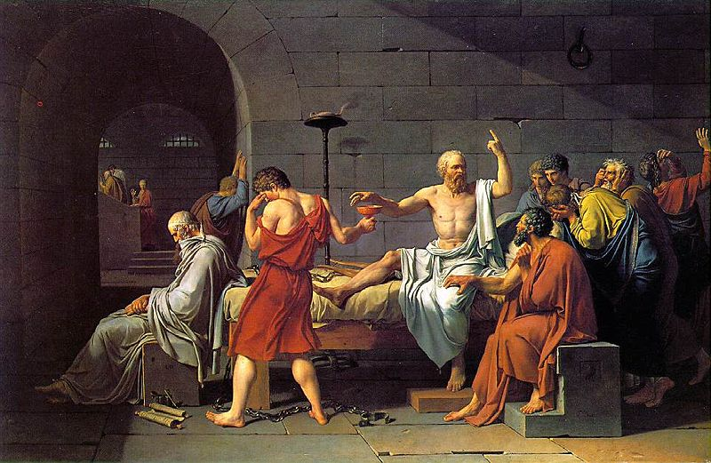
  As you hear or read an argument you should ask yourself:
  Is the argument persuasive?
  To whom is the argument persuasive?
There are several ways to appeal to an audience.
Among them are appealing to logos, ethos and pathos.
These appeals are prevalent in almost all arguments.
This painting by Jaques –Louis David is called, “The Death of Socrates.”

Slide 7
Ethos, Pathos and Logos
1. Ethos = an ethical or moral argument
2. Pathos = an emotional argument
3. Logos = a logical argument

Slide 8

Ethos
The word "ethos" came from the Greek word ethikos meaning moral or showing moral character.
Speaker must establish moral credibility in the minds of the audience at the beginning of his or her speech.
Speaker must show that he or she has expertise in the subject matter of the speech and that he or she is disconnected from topic (i.e., the speaker does not and will not have a direct interest or an ulterior motive for convincing their audience).
For example, when a trusted doctor gives you advice, you may not understand all of the medical reasoning behind the advice, but you nonetheless follow the directions because you believe that the doctor knows what s/he is talking about.

Slide 9

Ethos = an appeal to ethics
Ethos: Ethos is related to the English word ethics and refers to the trustworthiness of the speaker/writer.
Ethos is an effective persuasive strategy because when we believe that the speaker does not intend to do us harm, we are more willing to listen to what s/he has to say.
For example, professional football players have established their credibility in sports by playing in the NFL. If LT tells us that VIZIO is the best plasma television for watching the game, we believe that he knows what he is talking about.

Slide 10

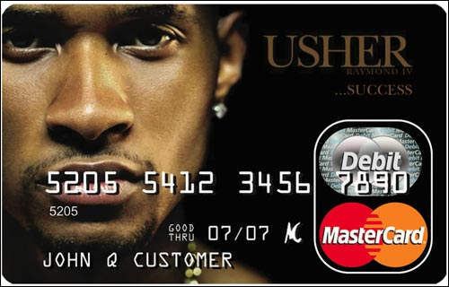

Slide 11

Pathos = an emotional argument
An effective use of pathos will alter the mindsets of the audience through the use of emotional appeal.
Both words and pictures can achieve this appeal. In this picture, Haitian children are collecting water. Children and adults spend all day digging for water because most of Haiti does not have access to water.

Slide 12
Pathos
Pathos: Pathos is related to the words pathetic, sympathy and empathy.
Whenever you accept a claim based on how it makes you feel without fully analyzing the rationale behind the claim, you are acting on pathos.
Those who wish to persuade you will play with your emotions. They may persuade you with fear, love, patriotism, guilt, hate or joy.
A majority of arguments in the popular press are heavily dependent on appealing to your emotions. We, as a society, should not react to emotional arguments without fully considering all of the facts.

Slide 13




Slide 14
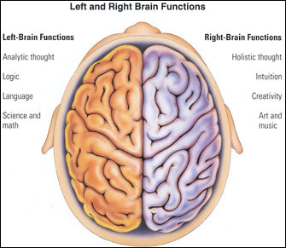
Logos
Logos means logic
Logos refers to any attempt to appeal to the intellect: making a logical argument.
Logos appeals to the left side of the audience's brain. The audience finds certain patterns, conventions and modes of reasoning to be convincing and persuasive. The audience relies on reasoning and facts to make its decision. Numbers, polls and statistics are also examples of the persuasive use of logic.

Slide 15
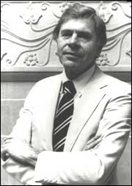
Logos
Let us begin with a simple proposition: What democracy requires is public debate, not information. Of course it needs information too, but the kind of information it needs can be generated only by vigorous popular debate. We do not know what we need to know until we ask the right questions, and we can identify the right questions only by subjecting our ideas about the world to the test of public controversy. Information, usually seen as the precondition of debate, is better understood as its by product. When we get into arguments that focus and fully engage our attention, we become avid seekers of relevant information. Otherwise, we take in information passively--if we take it in at all.
Christopher Lasch, "The Lost Art of Political Argument"

Slide 16
REVIEW
Ethos, Pathos and Logos
1. Ethos = an ethical or moral argument
2. Pathos = an emotional argument
3. Logos = a logical argument

Slide 17
Let’s Practice!
Identify the rhetorical strategy used in each commercial …
https://www.youtube.com/watch?v=7OIEFo2axGE&index=1&list=PL07FB5798655A15F6
http://www.youtube.com/watch?v=ZKB9fgQpkLk&list=PLB759AD429C749932
http://www.youtube.com/watch?v=1mhrsCFAmYs&list=PLB759AD429C749932
https://www.youtube.com/watch?v=SKL254Y_jtc

Slide 18
Answers…
1) Logos- Geico
2) Pathos - Allstate insurance
3) Pathos- Target Xmas
4) Ethos- Chrysler (Eminem and Motor City)

